Slide 1
Project of BAC
Auteur :
Part : Dorian Bucchiotty

Slide 2
Presentation
Project of Escape Games :
The theme is based on futuristic spaceship.
The game in the room where there are many puzzles.
The puzzles serve to continu on others puzzles for finish the game.

Slide 3
Contents
First part
Diagram of bloc
List of components
Technological solutions
Chain energy

Slide 4
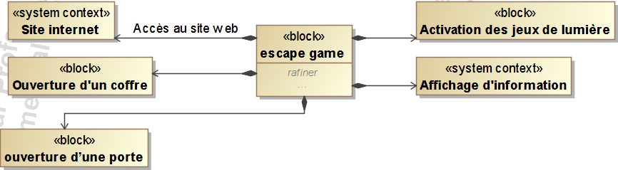
Diagram of bloc

Slide 5
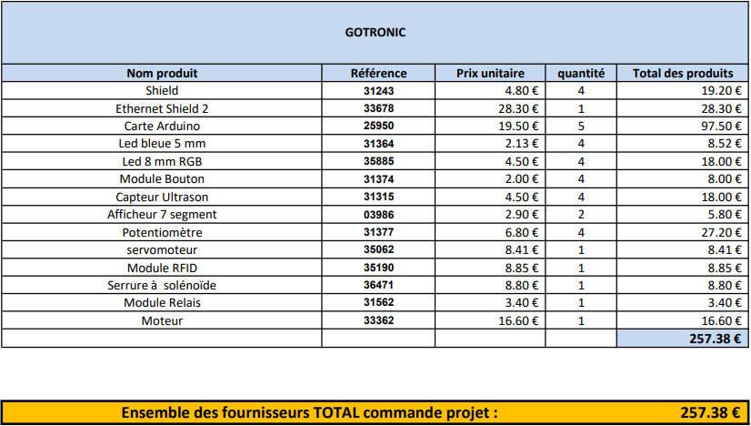
List of components

Slide 6
Technological solutions
Code enter system | Keyboard to code | Potentiomètre | Keyboard Tactile
Advantage : | Cheap | Playful and cheap | Modern
Disadvantage : | Simple | Difficult to install | Expensive
Adapt : | No | Yes | No
Lock system for chests | Lock electronic | Lock system with Servomotosr | Mechanical lock
Advantage : | Reliable | Cheap | Simple pas chère
Disadvantage : | Expensive | Difficult to install | Not suitable for the project
Adapt : | No | Yes | No

Slide 7
Technological solutions
Connect of system | Wifi | Bluetooth | Wire
Advantage : | Fast | Slow and high distance | Cheap and fast
Disadvantage : | Expensive | Short distance and expensive | Imposing
Adapt : | No | No | Yes

Slide 8
Chain energy
Chain information
Energy electric
Energy electric
Energy mechanical
Power
Distribute
Convert
Transmit
Prise secteur + transformateur
Carte Arduino
Servomoteur
Réducteur + tige
input 230 V and transformer output 5V
For lock and unlock the system
Secteur 230V
Ouverture/fermeture du coffre

Slide 9
Thank you for your attention

